Slide 1

Progress report Group 24

Slide 2
Scenario
YouTube is currently the most famous video-streaming platform, receiving billions of views and video uploads every-day.
We will delve into the statistics the most trending videos on YouTube (fetched from YouTube’s Trending Videos page) in an effort to identify the factors that influence YouTube trends, as well as how YouTube’s algorithm works.
This may give us a brief overview into what is trending today, what can influence our minds the most, etc.

Slide 3
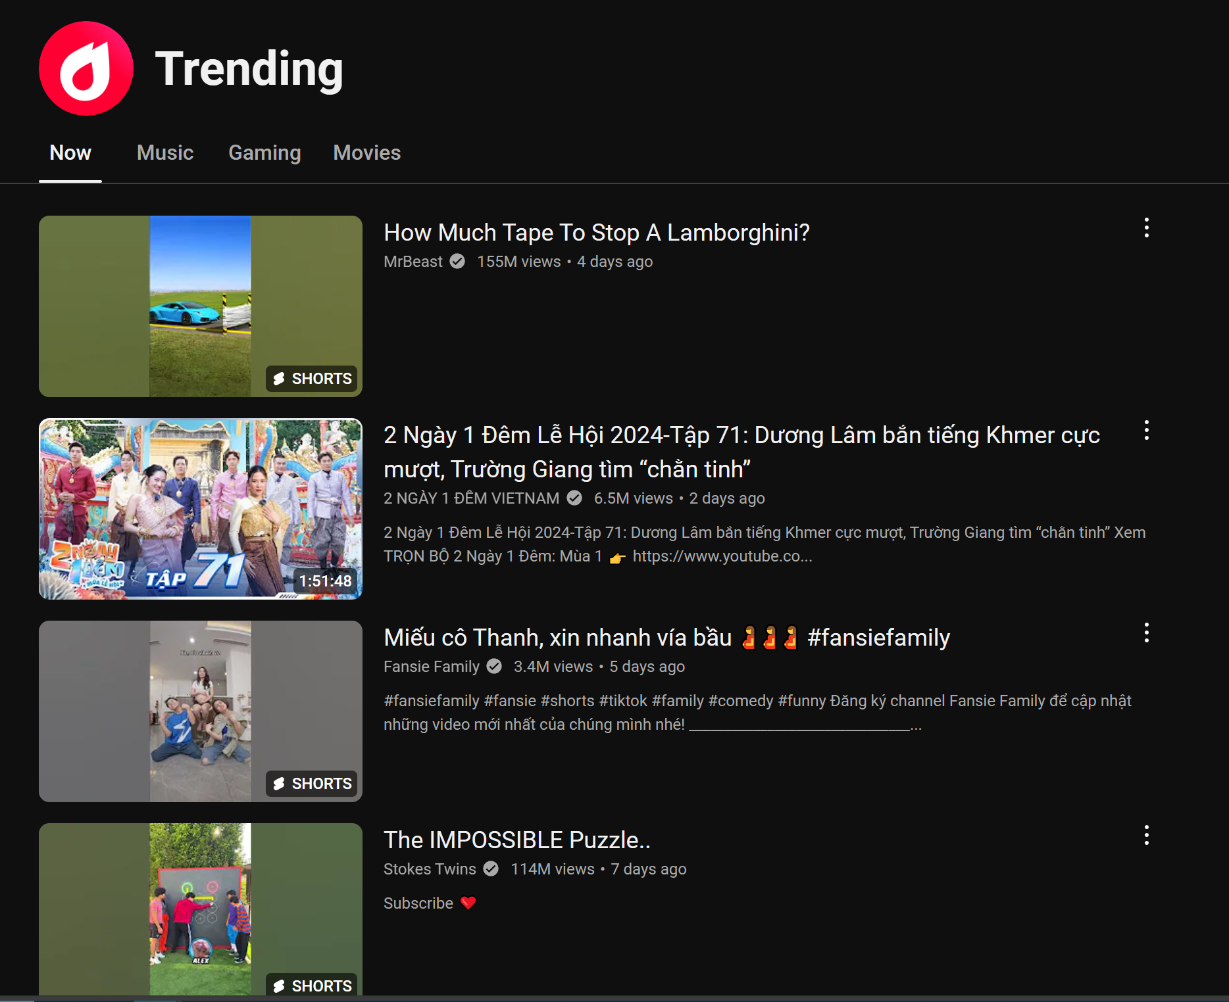
The youtube trending page
Website directory: https://www.youtube.com/feed/trending?
The displayed videos will vary depending on the territory YouTube is accessed in.

Slide 4
About our dataset
To ensure correct process of the text columns, we choose 5 English-speaking countries to perform analysis: Australia (AU), Canada (CA), Great Britain (UK), United States (US), and India (IN) (Indian contents (title, description, etc. are mostly English)
We have finished fetching the data for each country, pre-processing is still under way.

Slide 5
About our dataset
Initially, there will be 5 datasets for each country, containing the information of the latest trending videos (as updated in 12/11/2024) in those countries, with the following properties

Slide 6
Dataset properties (raw)
Column name | Purpose
title | The video title
publishedAt | Date (YY-MM-DD) and time (hh:mm:ss) at which the video is published
channelTitle | Name of the channel that posts the video
description | Description (under the video)
category | The video category (1 in 44 standard YouTube categories)
tags | The video tags, normally not shown, but fetch-able via YouTube API
duration | The video duration, in minutes (for simplifying visualization & prediction tasks)
view_count | Number of views in the video
likes | Number of likes in the video (We can’t fetch number of dislikes due to YouTube policy)
comment_count | Number of comments in the video
subscriber_count | Number of subscriber to the channel (that posts the video)
engagement_rate | Engagement rate of the video, calculated by (likes + comments) / views. A good rate is over 0.3
total_view_count | The total views that the channel accumulated
channel_country | The home country of the channel

Slide 7
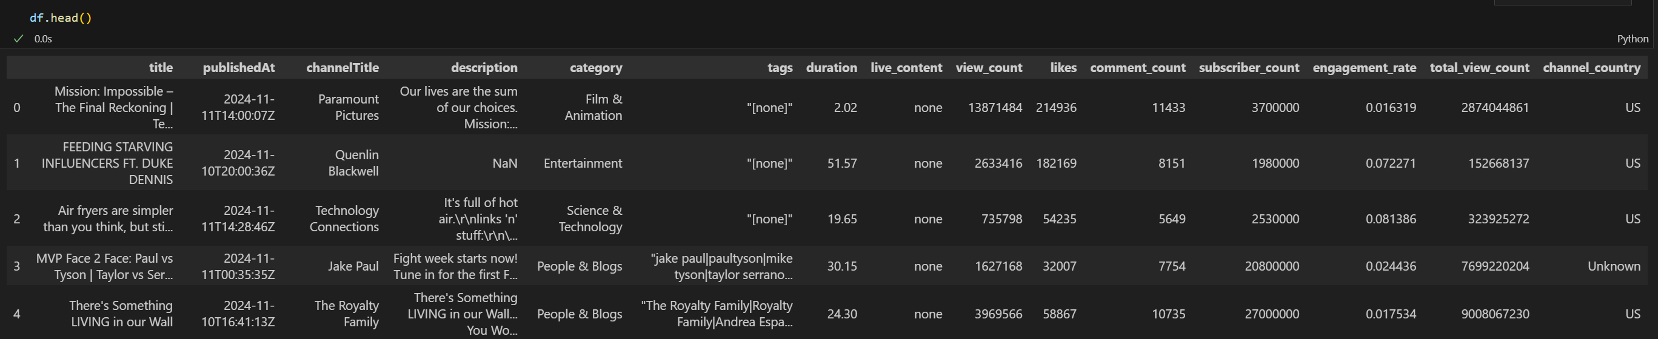
Raw dataset (from script) sample
Dataset in pre-procession. Please consider this as initial reference only.
The finalized datasets can be considerably different from these samples.

Slide 8
Sub-DATAset Properties
Column name | Purpose
channelTitle | Name of the channel that are on trending
category | The channel category (1 in 44 standard YouTube categories). Normally, the channel category will follow its videos
subscriber_count | Number of subscriber to the channel (that posts the video)
total_view_count | The total views that the channel accumulated
channel_country | The home country of the channel
Channel_info.csv: Basic information of the channels in the trending list

Slide 9
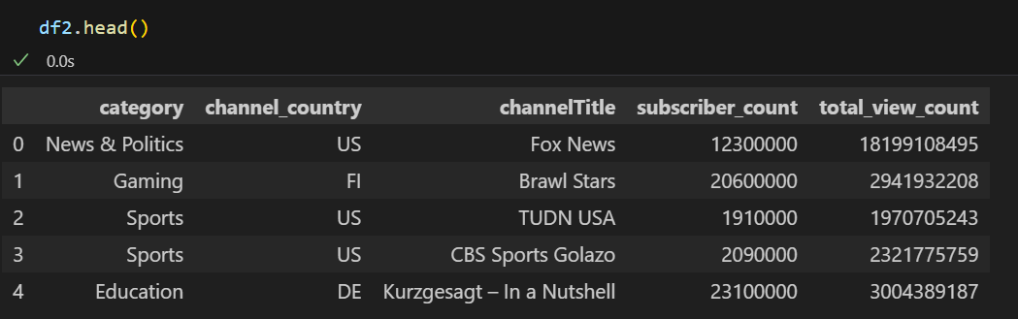
Channel_info Dataset sample (US)
Dataset in pre-procession. Please consider this as initial reference only.
The finalized datasets can be considerably different from these samples.

Slide 10
Sub-DATAset Properties
Column name | Purpose
title | The video title
channelTitle | Name of the channel that post the video
category | The video category (1 in 44 standard YouTube categories).
channel_country | The home country of the channel
date & time | Separated publishedAt column (has date & time) of the video
duration | The duration (in minutes) of the video
view_count | The view count of the video
likes | The number of likes in the video
comment_count | The number of comments in the video
engagement_rate | The engagement_rate of the video (likes + comment_count / view_count)
tags | The tags of the video
description | The video description
videos_info.csv: Information of the videos in the trending list

Slide 11
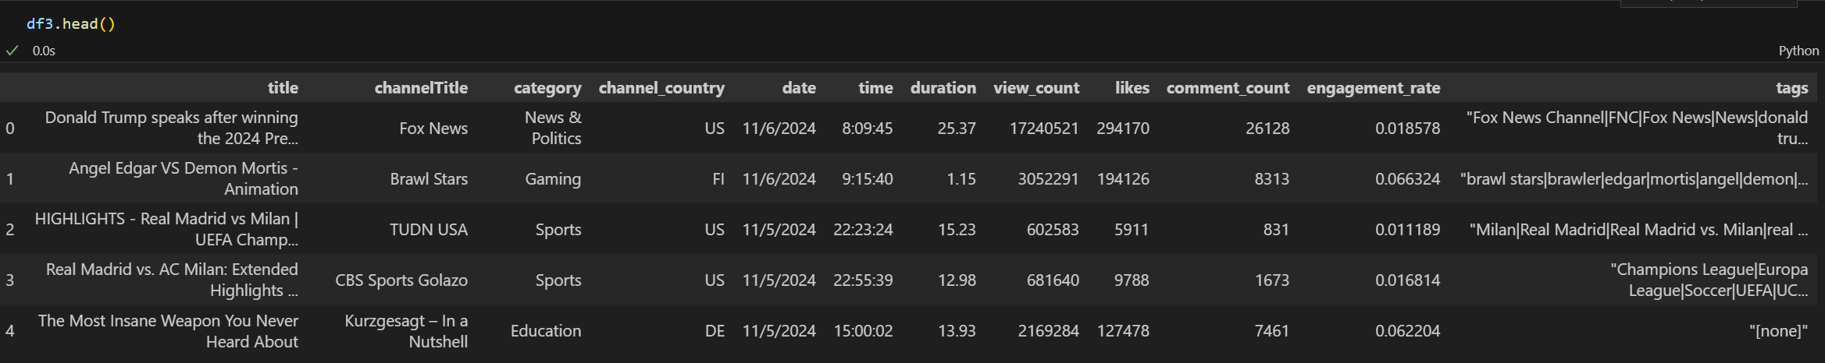
Videos_info Dataset sample (US)
The “description” column is not shown because we separated it out for further procession using some NLP tools (summarization)
Dataset in pre-procession. Please consider this as initial reference only.
The finalized datasets can be considerably different from these samples.

Slide 12
Future plans & objectives
We will further organize our datasets to make it ready for analysis tasks.
A visualization (using PowerBI) will be made to provide a clear way to track trends and patterns that influence trends.
Some exploratory comments may be included to see how trends on YouTube evolves.
A prediction tool is currently in production, to estimate whether a certain video has the potential to go viral with the provided properties (title, published time, duration, category, etc.)
If time allows us, we will introduce cross-month analysis (the trending page can change drastically within a few weeks)

Slide 13

Thank you For listening
Group members

